Slide 1
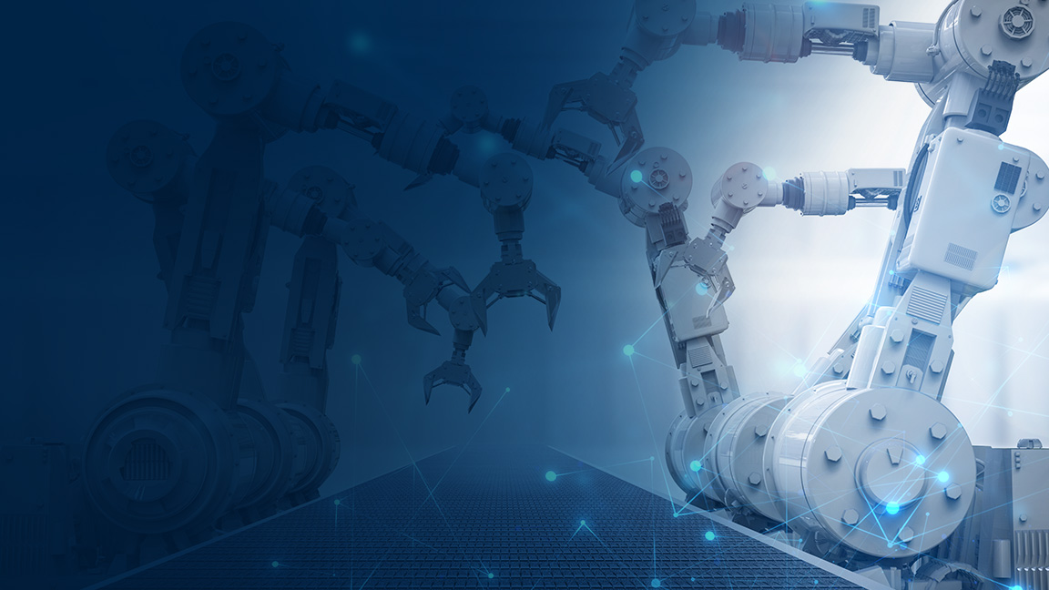
Virtualization and Real-Time Systems for Work Load Consolidation
Core and Visual Computing Group, Intel®

Slide 2
Legal Notices and Disclaimers
Intel technologies’ features and benefits depend on system configuration and may require enabled hardware, software or service activation. Performance varies depending on system configuration. No computer system can be absolutely secure. Check with your system manufacturer or retailer or learn more at www.intel.com.
This document contains information on products, services and/or processes in development. All information provided here is subject to change without notice. Contact your Intel representative to obtain the latest forecast, schedule, specifications and roadmaps.
Any forecasts of goods and services needed for Intel’s operations are provided for discussion purposes only. Intel will have no liability to make any purchase in connection with forecasts published in this document.
ARDUINO 101 and the ARDUINO infinity logo are trademarks or registered trademarks of Arduino, LLC.
Intel, the Intel logo, Intel Inside, the Intel Inside logo, OpenVINO, Intel Atom, Celeron, Intel Core, and Intel Movidius Myriad 2 are trademarks of Intel Corporation or its subsidiaries in the U.S. and/or other countries.
*Other names and brands may be claimed as the property of others.
Copyright 2018 Intel Corporation.
2

Slide 3
IIOT Workshop Overview
Introduction
Physical Sensors and Actuators
Communications and Protocols
Control
Introduction to Intel and the IIoT
Formalized Structure to IIoT
Work Load Consolidation
Operations
Each Module contains a lecture and a hands-on lab exercise that builds towards an model of an IIoT infrastructure based on a formalized architecture.
Security and IIoT
Smart Video Systems
Information
Predictive Analytics
Business Analytics
Application
Industrial IoT Workshop Content: https://goo.gl/Stt9mD
Notes:
IIoT Workshop Overview
This slide gives a brief outline of the material covered in the Intel Industrial IoT Workshop. You can use this slide to give a quick overview of the topics and will be covered.
You can always find the latest course outline on Github.
https://github.com/SSG-DRD-IOT/Industrial-IoT-Workshop
Topics
Introduction to the Industrial Internet of Things and the workshop including:
Overview of the topics and the hardware
What is Industry 4.0?
What business opportunities and solutions will Industry 4.0 provide?
What are the key technologies that enable new value in Industry 4.0?
Continuous Visibility into business processes by deploying physical sensors and using analytics, digital twins and machine learning creates a Virtuous Cycle.
What Pilot Opportunities can your business begin to harness the Industrial IoT
Formalizing the IIoT – We will give an overview of the Industrial Internet Consortium (IIC) and create a architecture based on their whitepapers.
Physical Sensors and Actuators – We will explore the hardware sensors in the Up2 Grove IoT Development Kit and use Arduino Create to build a couple of sensor based labs
Communications and Protocols – We will talk about scalability in a IIoT network and three protocols MQTT, OPC-UA and DDS
Automation – Reactions based on sensor data
Smart Video System – the Intel CV SDK which includes OpenVX and OpenCV as well as the deep learning kit and the inference engine.
Machine Learning, Predictive Analytics, and Business Analytics will be written for the 2 day workshop.
Industrial IoT or Industry 4.0 has arrived at the doorstep many of the industrial companies and going forward high investment will flow into new digitalization processes changing the way the industrial ecosystem will operate. This workshops is an introduction in the concepts and formal architectures of Industry 4.0. The workshop is divided into modules. Each Module contains a lecture and a hands-on lab exercise that builds towards a test prototype of an IIoT infrastructure based on the Industrial Internet Consortium’s IIoT Reference Architecture and Intel technology.
In the second module, we will introduce a formal structure for realizing an IIoT deployment. The later modules fit

Slide 4
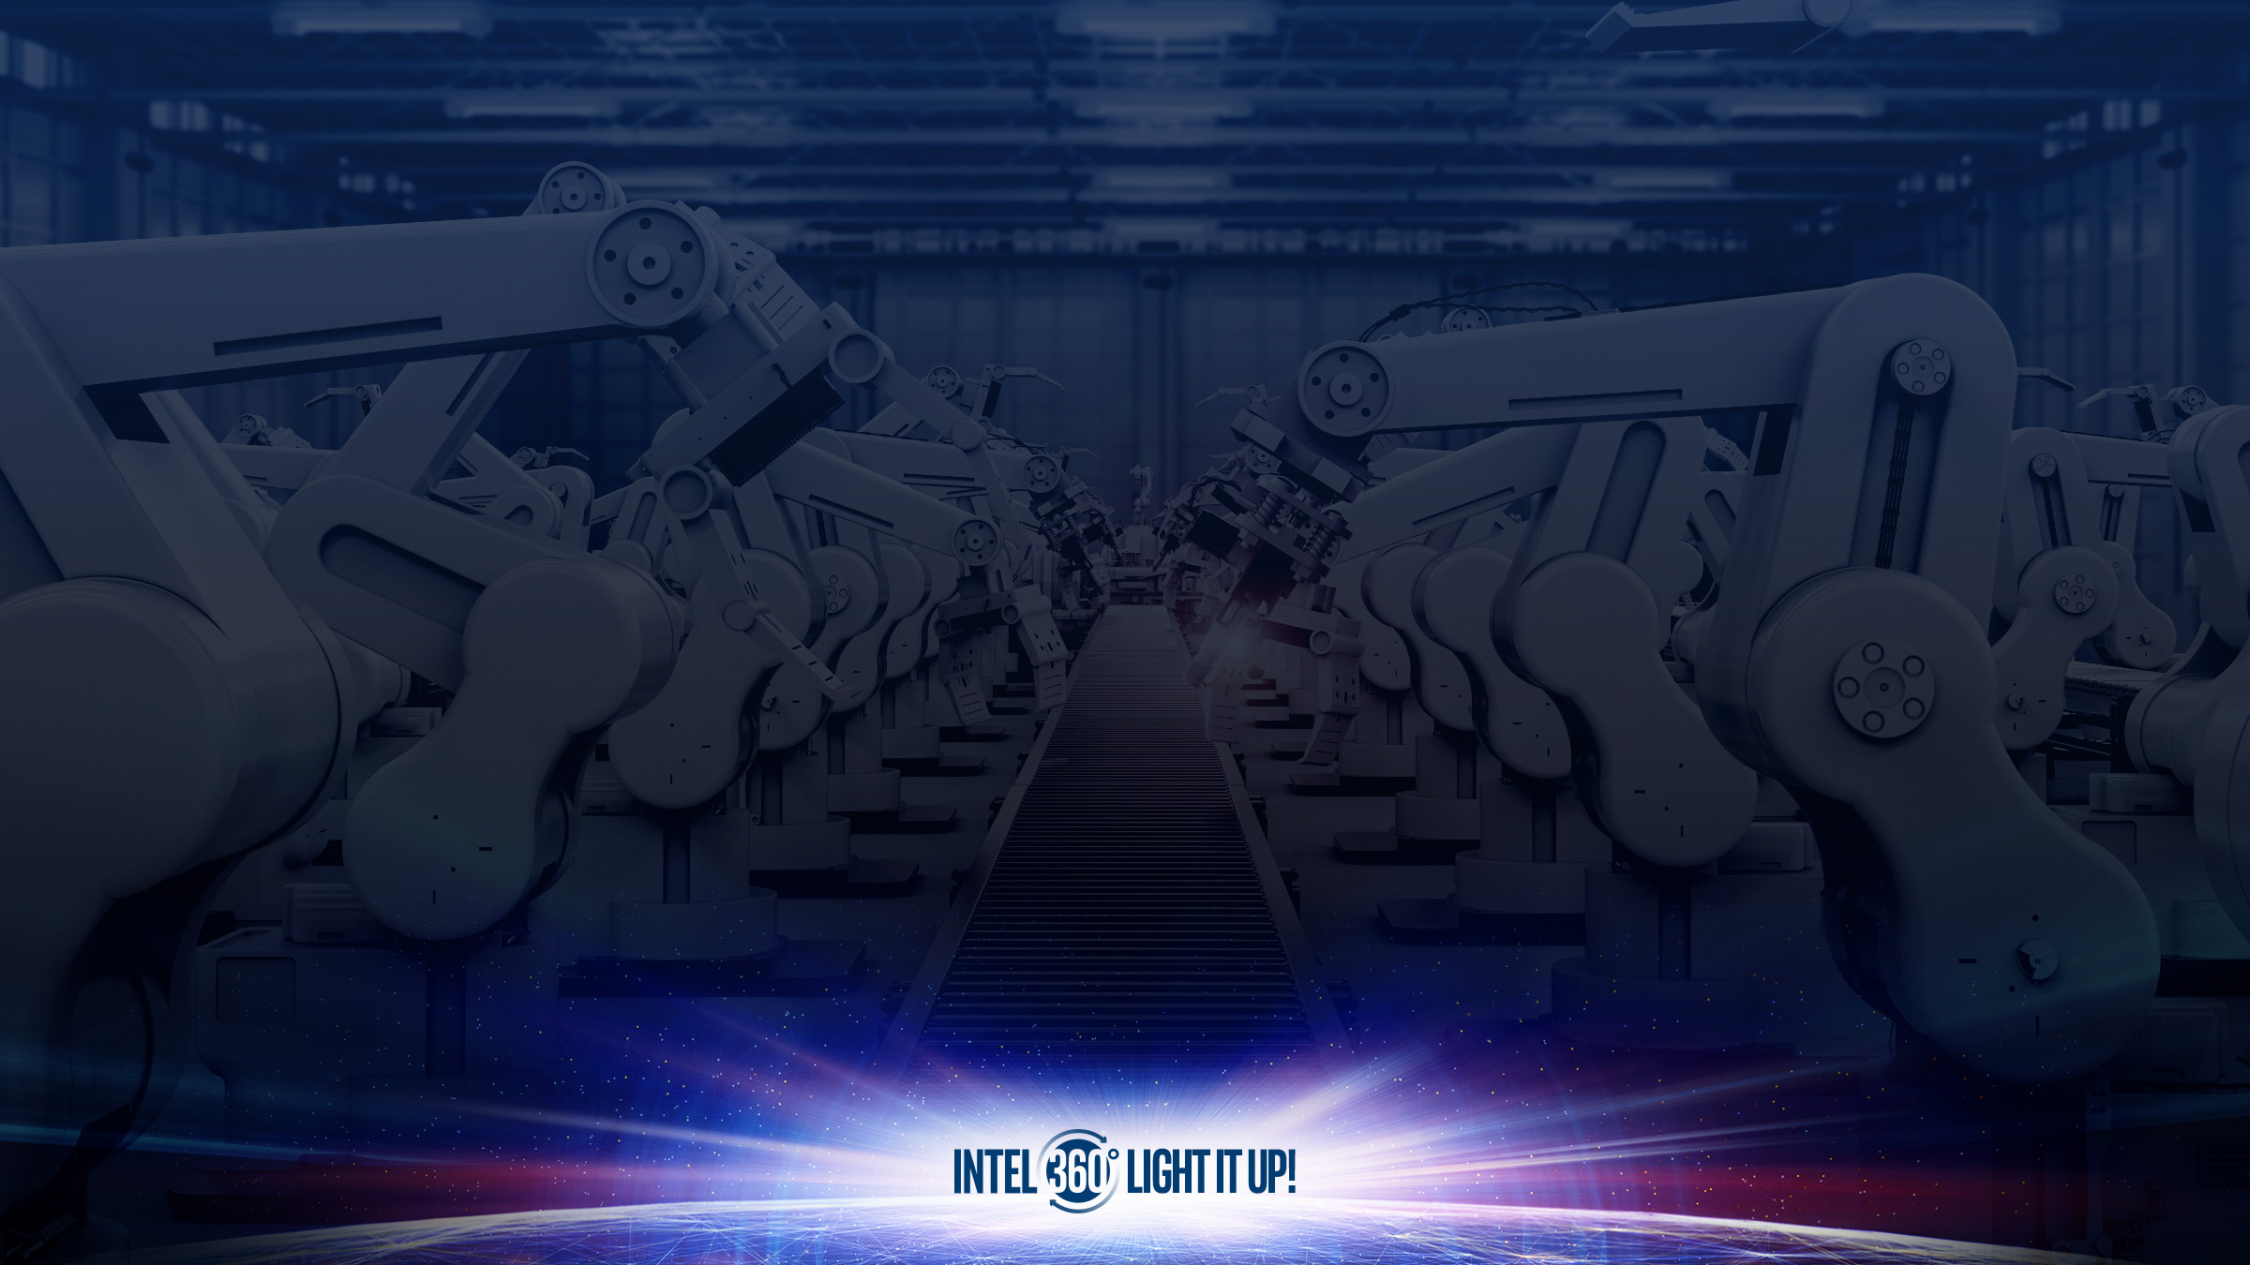
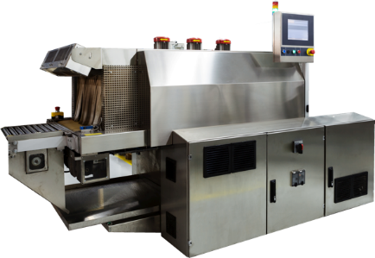
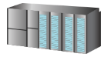
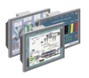


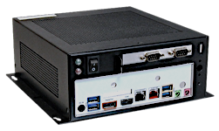



Workload Consolidation is a Key strategic focus
MANY CUSTOM DEVICES
PLC
HMI
VISION
MOTION
EXPANDABLE, HIGH PERFORMANCE COMPUTE
LOWER COSTS, INCREASE YIELD AND FLEXIBILITY
$
INVEST in workloads THAT Consolidate compute (ATOM→CORE→XEON)
3
Notes:
Invest in compute hungry workloads to drive need for Edge Compute (Atom→Core→Xeon)
Workload examples include: legacy applications, control functions, analytics
Workload consolidation is defned as the discipline of simplifying and optimizing end-to-end information technology (IT) infrastructures, including servers, databases, applications, networks, security, and systems management capabilities, with the goal of fnding ways to better align the IT infrastructure to meet both current and future requirements.1 In the industrial landscape, it means merging diﬀerent dedicated hardware controls such as programmable logic controllers (PLCs), programmable automation controllers (PACs), human-machine interfaces (HMIs), and many other control loops into one device. Workload consolidation unites multiple workloads from a business’ data center and Internet of Things (IoT) infrastructure onto a virtualized platform to replace purpose-built machines. Powered by a single infrastructure, workload consolidation drives compute-heavy workloads, like artifcial intelligence (AI) and computer vision (CV), at the edge. A key technology feature that enables workload consolidation is virtualization. Virtualization is the creation of a virtual (rather than actual) version of something, such as an operating system, a server, a storage device, or network resources.2 A key use of virtualization technology is server virtualization, which uses a software layer called a hypervisor to emulate the underlying hardware. This often includes the central processing unit's (CPU's) memory, input/output (I/O), and network trafc. The guest operating system, normally interacting with true hardware, is now doing so with a software emulation of that hardware, and often the guest operating system has no idea it is on virtualized hardware. While the performance of this virtual system is not equal to the performance of the operating system running on true hardware, the concept of virtualization works because most guest operating systems and applications don’t need the full use of the underlying hardware. This allows for greater ﬂexibility, control, and isolation by removing the dependency on a given hardware platform.2 As factory automation moves closer to consolidating applications, another important technology, containerization, is also gaining traction. If virtualization was designed to address consolidation of servers and resources, containerization was designed to solve a more modern problem: application management issues. While similar and with similar benefts, [containerization is] not a replacement for virtualization—it is complementary to it.8 Containerization, also called container-based virtualization and application containerization, is an operating system (OS)-level virtualization method for deploying and running distributed applications without launching an entire virtual machine (VM) for each application. Instead, multiple isolated systems, called containers, run on a single control host and access a single kernel.3 Containerization makes applications portable by virtualizing at the operating-system level, creating isolated, encapsulated systems that are kernel-based. From there, distributed, containerized apps can be dropped in anywhere and run without dependencies or requiring an entire VM. Its other main beneft is that it requires far fewer resources. For instance, you can run numerous containers at once without taking up a lot of space, whereas with virtualization, doing the same can require many more GBs of space.4

Slide 5





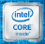

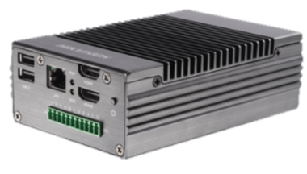
WORKLOAD Consolidation for edge computing 6 Enabling Technology Pillars Powered by IA + Workload Accelerators
Virtualization
FUSA
Security
Artificial
Intelligence
Machine Vision
Real
Time
Edge Server
Multi-Function Controller
Edge Gateway
Manufacturing
Machine
Notes:
Invest in compute hungry workloads to drive need for Edge Compute (Atom→Core→Xeon)
Workload examples include: legacy applications, control functions, analytics

Slide 6
Digital Transformation and Workload Consolidation
Technology drives value in businesses in four ways: enhanced connectivity, automation of manual tasks, improved decision making, and product or service innovation. Tools such as big-data analytics, apps, workﬂow systems, and cloud platforms – all of which enable this value – are too often applied selectively by businesses in narrow pockets of their organization. When used well, digital expands the improvements delivered in one part of an organization across the whole value chain.
--McKinsey & Company’s article, Finding Your Digital Sweet Spot,8 authors ’Tunde Olanrewaju and Paul Willmott
Notes:
Digital Transformation and Workload Consolidation Digital transformation is the profound transformation of business and organizational activities, processes, competencies, and models to fully leverage the changes and opportunities of a mix of digital technologies and their accelerating impact across society in a strategic and prioritized way, with present and future shifts in mind.7 In our key market segments – industrial, energy, and smart building – customers are looking to digital transformation to become smarter, faster, safer, and more efcient. In McKinsey & Company’s article, Finding Your Digital Sweet Spot,8 authors ’Tunde Olanrewaju and Paul Willmott assert: Technology drives value in businesses in four ways: enhanced connectivity, automation of manual tasks, improved decision making, and product or service innovation. Tools such as big-data analytics, apps, workﬂow systems, and cloud platforms – all of which enable this value – are too often applied selectively by businesses in narrow pockets of their organization. When used well, digital expands the improvements delivered in one part of an organization across the whole value chain.

Slide 7
Why Consolidate Computing Tasks?
Business Drivers
Customer Drivers
Lower OPEX/CAPEX
Lower Downtime
Faster Time to Revenue
Increased Output/Yield
Aging Workforce
Interoperability for Best of Breed
Increased Security Risk
Increased Flexibility/Portability
Notes:
Ask for specific examples that can be shared

Slide 8
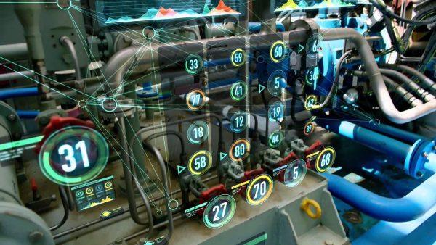
Industrial Requirements Influencing Workload Consolidation
Worst Case Execution Time
Bandwidth Capability
Logical Isolation
Determinism
Platform Requirements
Notes:
Industrial Requirements Inﬂuencing Workload Consolidation When approaching workload consolidation, there are several factors that customers need to take into consideration. These factors and their impact on the design of the target platform are discussed below.
Worst Case Execution Time: Usage models for workloads characterize what is the longest execution time that is acceptable for the workload in order for the use case to be successful. This is known as the tolerable Worst Case Execution Time (WCET). Each workload needs to be characterized to determine its acceptable WCET. Often, the WCET is defned subjectively, but care should be taken to ensure that the defnition has a business justifcation for why a violation of the WCET would fail the use case. For workloads that are interactive in nature (e.g., HMI), the WCET is simply an observed tolerable wait time for the application to respond. Non-interactive workloads range from periodically scheduled batch jobs that perform functions such as data transformation and transfer from source to destination to applications that control the functioning of manufacturing tools on the shop ﬂoor. Batch jobs typically defne their WCET as the duration beyond which they would interfere with other jobs or would simply fail to complete before the next cycle starts. Control applications typically have stringent time determinism specifcations and require WCET to not exceed a very tight window that may span only microseconds. Such control applications require the utmost attention when planning and testing for workload consolidation. Designing a platform to consolidate multiple workloads needs to ensure that WCET requirements for individual workloads are respected.
Bandwidth Capability: Individual workloads have requirements for the peak amount of data transferred during the workload’s life cycle. The data transfer rate is known as “bandwidth.” Bandwidth requirements of workloads executing on a platform increase and decrease over their life cycle, but never exceed the specifed peak bandwidth requirement. The platform’s bandwidth capabilities are well known and specifed by the platform provider ahead of time. A consolidated platform needs to support the sum of the peak bandwidth requirements for all workloads being consolidated (i.e., the platform’s bandwidth capability needs to be equal to or greater than the sum of the workload bandwidth requirements). If the workloads are time division multiplexed (TDM), where individual workloads’ bandwidth needs don’t peak at the same time, it is possible that the platform may support the peak bandwidth requirements of the workloads that exceed its peak bandwidth capability.
Logical Isolation: Workloads may have a need for logical isolation or logical partitioning from each other. This means that a given workload executing on a system is unaware of the other workloads on the system and is guaranteed that no other workloads on that system will interfere with its execution and address space. This is typically achieved through Virtualization Technology (VT). Such logical partitioning requirements of the workloads play an important role in determining how much consolidation is possible on a given platform. VT adds a certain overhead on the platform, and also limits what underlying resources are accessible by individual workloads in order to ensure they do not trespass certain boundaries. Needs for VT for a given platform are important considerations when determining what workloads can be consolidated on that platform.
Determinism: Workloads that are time deterministic in nature impose strict timely execution (temporal) requirements. Such workloads need to have temporal isolation in order to not experience interference from other workloads in accomplishing their time-deterministic execution deadlines. This is typically accomplished through a combination of one or more capabilities such as time-determinism features of the underlying platform, VT support, etc. If the workloads are staggered in time for execution, the platform may be able to achieve better consolidation through TDM. Designing a consolidated platform needs careful attention to the temporal requirements of the individual workloads.
Platform Requirements: The storage and power requirements of workloads also need to be considered when consolidating them onto a platform. The sum of the storage requirements of the workloads needs to be supported by the platform over which the consolidation is targeted. The processing requirements for the workloads dictate
Workload consolidation is typically accomplished by virtualization. In the industrial automation application space, the International Society of Automation’s ISA-95 model is the standard that drives consolidation for integrating enterprise and production control systems.

Slide 9
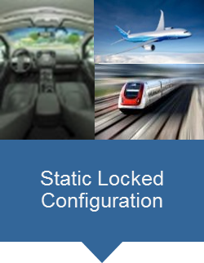
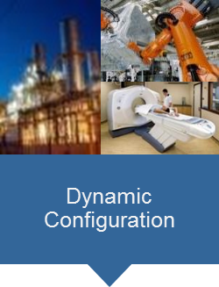
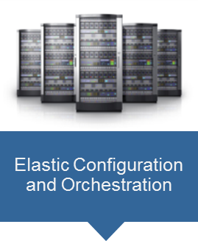
Virtualization is a key enabler for workload consolidation
ISOLATION
VIRTUALIZATION SPECTRUM
SCALABILITY
Separation kernels (e.g.VxWorks 653)
Real-Time Hypervisors (e.g. VxWorks HV, RTS, ACRN)
Linux Open Virtualization (e.g. KVM, bhyve)
Container Engines (e.g. Docker)
Cloud-Like Infrastructure at the Edge (e.g. Openstack, Titanium Control, Azure Stack)
Notes:
This slide should be a hardware/software stack showing the different level at which you can intercept with virtualization.

Slide 10
Virtualization Intercept Points
Industrial PaaS Offerings
GE Predix*, Siemens MindSphere, Schneider ExoStruxure, Hitachi Lumada*
Workloads
Virtual PLCs
Analytics
HMI
Legacy Apps
Software
Orchestration Layer
OpenStack Heat*, Docker/Kubernetes, Appache Mesos*
OS, Virtualization, Accelerators
Titanium Control, Linux*/KVM, Docker, Azure Stack*, AWS Greengrass*
Hardware
SI Features and Accelerators
FPGA, Security, Graphics, Intel® VTx/d
Silicon
Intel® Core™/Intel® Xeon® Processors
Notes:
This slide should be a hardware/software stack showing the different level at which you can intercept with virtualization.

Slide 11





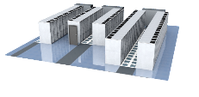
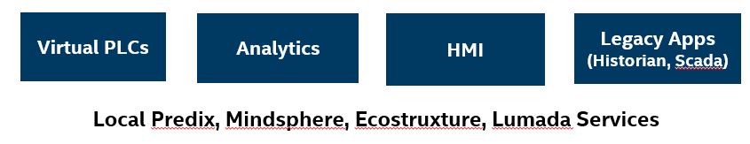
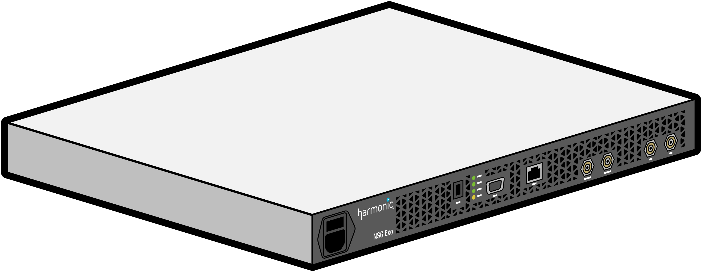
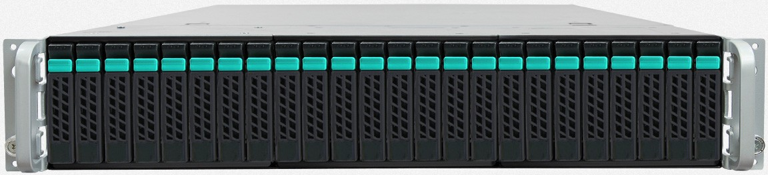
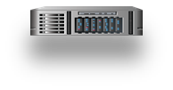
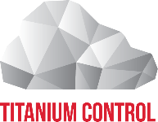
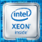
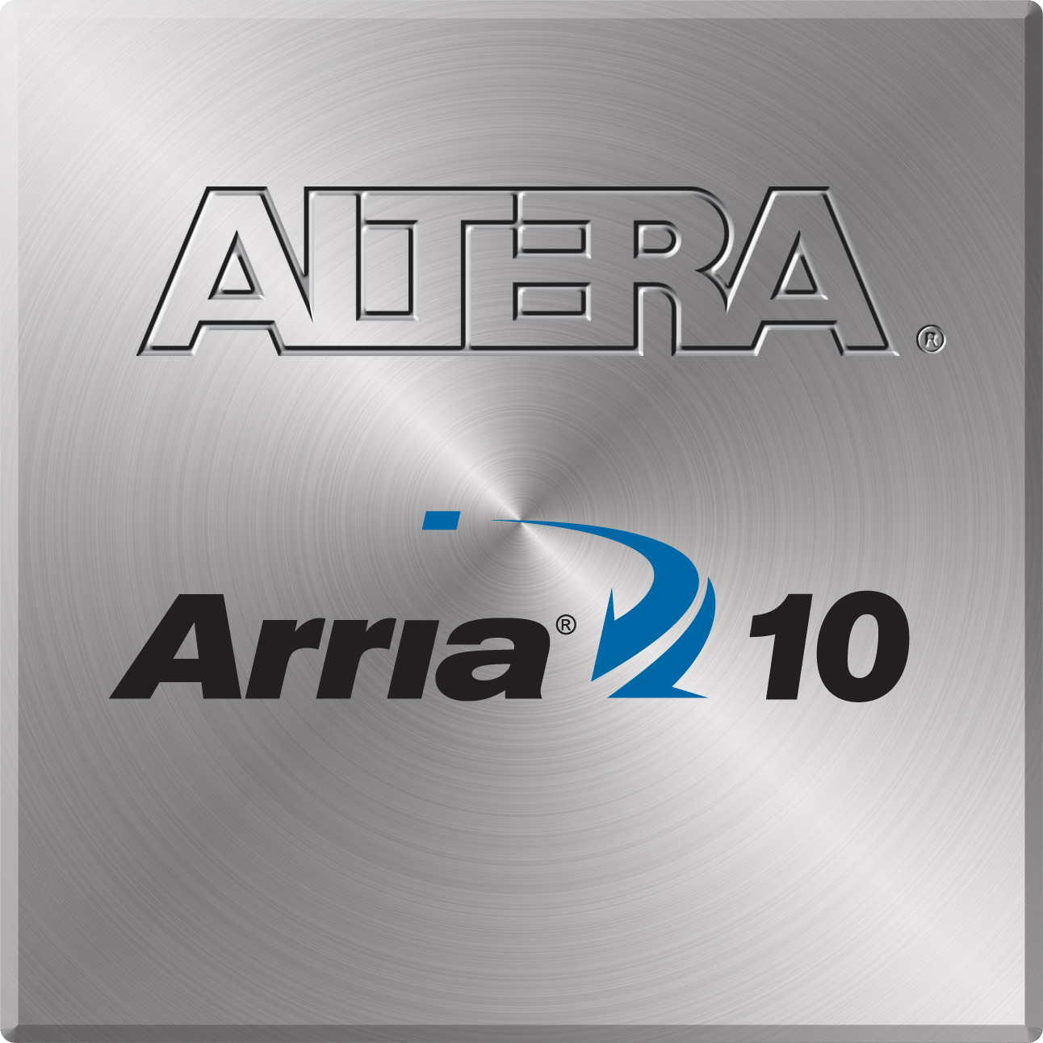
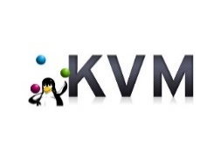

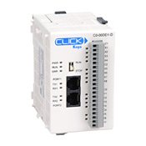
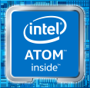
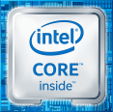
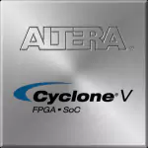
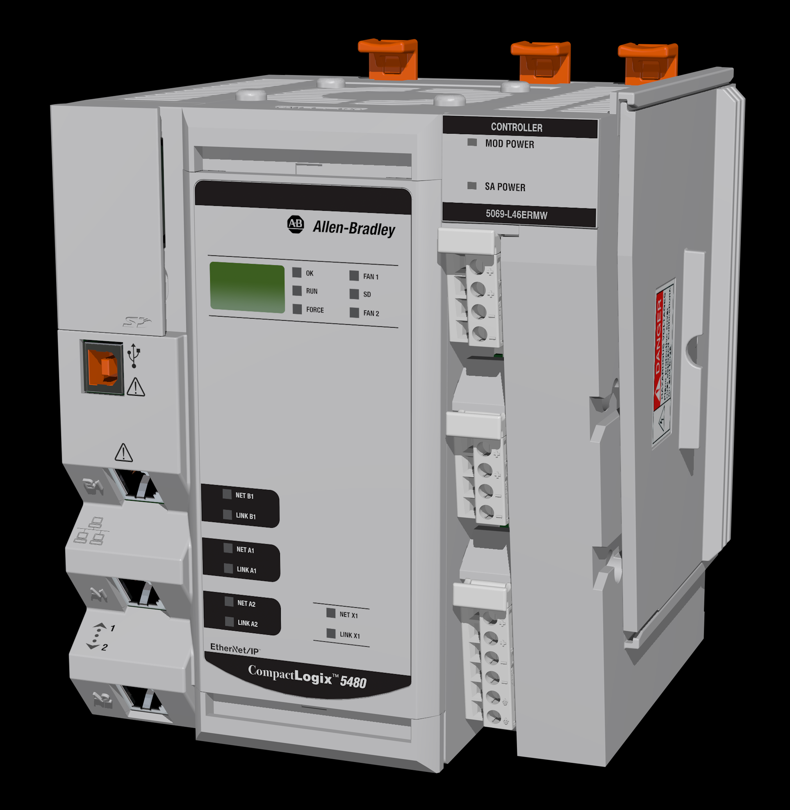

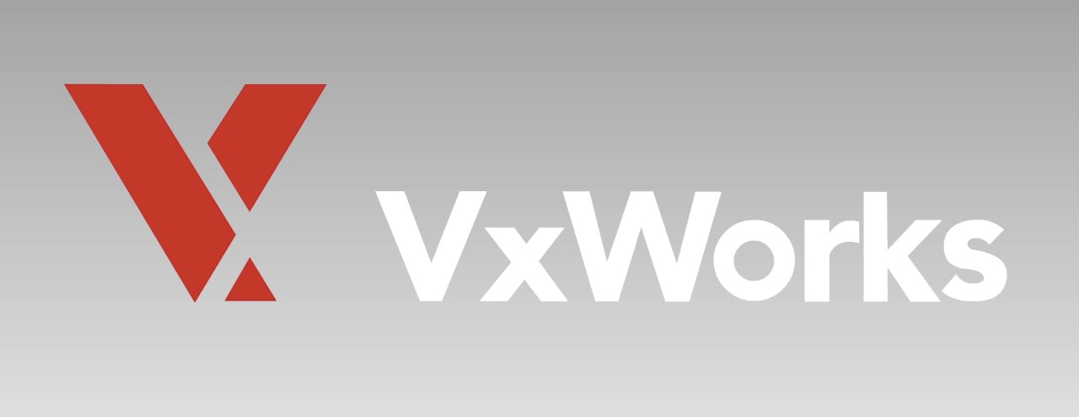

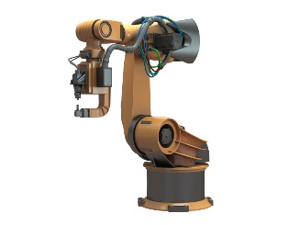

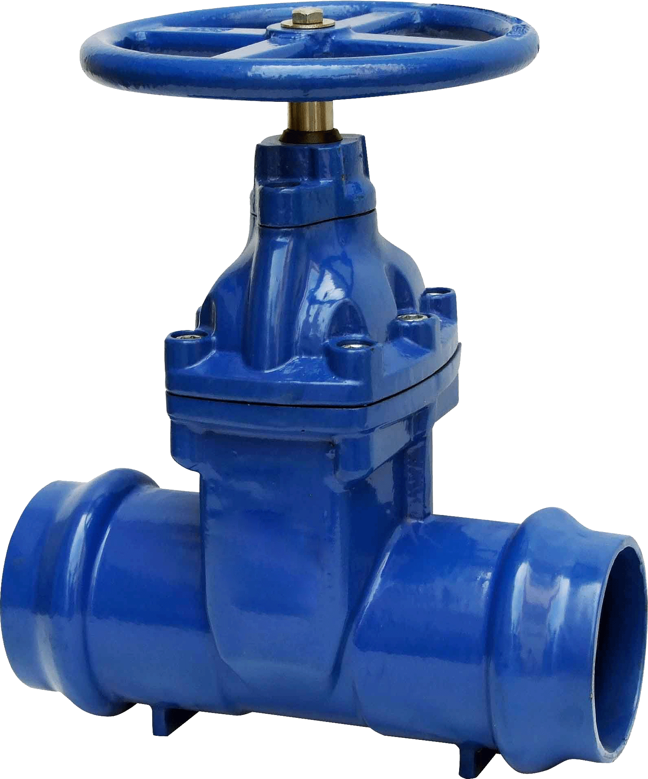

WHAT TO LOOK FOR: NEW product categories
Public or On-Prem Cloud Deployment
Edge Appliances
Traditional Gateway
Traditional IPC
Edge/Fog Server
Focus Areas
Edge
Controllers
Traditional PLCs, MCs, CNCs
Multi-function Controller
Devices
Notes:
KVM and HyperV

Slide 12

What is Intel® Virtualization Technology
Intel® Virtualization Technology (Intel® VT) is a multigenerational roadmap of increasingly powerful enhancements to Intel Processors, Chipsets and I/O devices. It is a complementary technology to virtualization software products that enhances today’s virtualization solutions and lays foundation for future platform virtualization. Intel® VT provides hardware assist to the virtualization software reducing its size and complexity enabling lower cost, more efficient, more powerful virtualization solutions.
Notes:
Virtualization abstracts hardware that allows multiple workloads to share a common set of resources. On shared virtualized hardware, a variety of workloads can co-locate while maintaining full isolation from each other, freely migrate across infrastructures, and scale as needed.
Businesses tend to gain significant capital and operational efficiencies through virtualization because it leads to improved server utilization and consolidation, dynamic resource allocation and management, workload isolation, security, and automation. Virtualization makes on-demand self-provisioning of services and software-defined orchestration of resources possible, scaling anywhere in a hybrid cloud on-premise or off-premise per specific business needs.
Intel® Virtualization Technology (Intel® VT) represents a growing portfolio of technologies and features that make virtualization practical by eliminating performance overheads and improving security. Intel® Virtualization Technology (Intel® VT) provides hardware assist to the virtualization software, reducing its size, cost, and complexity. Special attention is also given to reduce the virtualization overheads occurring in cache, I/O, and memory. Over the last decade or so, a significant number of hypervisor vendors, solution developers, and users have been enabled with Intel® Virtualization Technology
(Intel® VT), which is now serving a broad range of customers in the consumer, enterprise, cloud, communication, technical computing, and many more sectors.

Slide 13
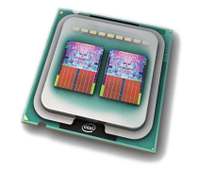
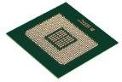
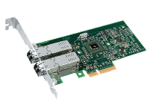
Quick Glance of Intel® Virtualization Technology
Intel® VT-x
Hardware assists for robust virtualization
Intel® VT FlexMigration – Flexible live migration
Intel® VT FlexPriority – Interrupt acceleration
Intel® EPT – Memory Virtualization
Intel® VT-x
Processor
Intel® VT-d
Intel® VT for Directed I/O
Reliability and Security through device Isolation
I/O performance with direct assignment
Chipset
Intel® VT for Connectivity
NIC Enhancement with VMDq
Single Root IOV support
Network Performance and reduced CPU utilization
Intel® I/OAT for virtualization
Lower CPU Overhead and Data Acceleration
Intel® VT-c
Network
Notes:
Combine this slide with the next slide

Slide 14
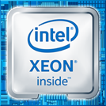
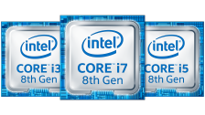
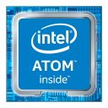

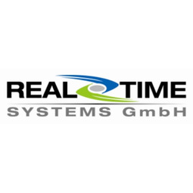

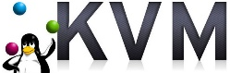



Intel virtualization products and technologies
Intel® VT is a cohesive portfolio of several hardware assist technologies that increase performance and the overall functionality of virtualization software and Intel solutions.
Technologies
Hardware
Solution Benefits
Intel® VT – x
Higher Privilege Ring: Reprioritized ring eliminates conflicts simplify hypervisor complexity, and improve capability with unmodified OS
Hardware Based Transitions: Reduces complexity of software transitions
Hardware Based Memory Protection: Accelerate Transition and ensure reliability of the process
CPU Virtualization
Memory Virtualization
Wide Range of Processors
Intel ® VT – d
Software
I/O Virtualization
Intel ® VT – c
Wide Range of Software*
Virtualization of Network Devices
Supported OSes
Other technologies
Intel Graphics Virtualization Technology¹
Wide Range of Operating Systems*
1. Intel GVT is an integrated feature that depends on the processor
Source: https://www.intel.com/content/www/us/en/virtualization/virtualization-technology/intel-virtualization-technology.html
*Other names and brands may be claimed as the property of others
Notes:
New Speaker Notes
Simple Sophisticated Technologies
Intel Virtualization Technology is collection of hardware assisted technologies that complements virtualization software and support virtualization solutions.
These technologies include: Intel VT-x that consists of Processor and Memory virtualization. This side is focus of powerful CPU use and dynamic memory. Intel VT-d has I/O virtualization that organizes and improves communications and paths. Intel VT-c focuses on networks and offered virtualization of network devices. We also have a feature that is its own category. Intel Graphics Virtualization Technology focuses on virtualizing media-rich workloads and it enables usages such as workstation remoting, desktop-as-a-service (DaaS), media streaming, and online gaming.
Top of the Class Hardware
Intel has built these technologies in a wide range of hardware that support virtualization solutions. The processor range from high performance Xeons Workstation to low power Atom Entry platforms. A processor that will fit any need. Also select Intel Ethernet Network Adapter offer Intel VT-c for network needs.
Virtualization Benefits
Lastly, is the high level overview of Benefits by using Intel VT for virtualized solutions. By having Intel VT as the foundation, virtualization solutions are optimized and enhances in a number of ways. Lower Bill of materials and decreased system footprint because hardware resources are virtualized and requires less of them. The solutions gain higher security and reliability through workload isolation, The list goes on. . .
Solution Benefits
Intel Virtualization Technology is designed to enable high performance hypervisor without the need for para-virtualization changes.
Higher Privilege Ring for the Hypervisor: Allows OS to run on reprioritized ring . Eliminates potential conflicts, simplify hypervisor complexity and improve compatibility with unmodified OS
Hardware Based Transitions: Handoffs between hypervisor and guest OS are supported on hardware, reduces the need for complex software transitions
Hardware based Memory Protection: accelerate transition and ensure reliability of retraining processor state details.
Old Speaker Notes
Even though virtualization is seen as a software technology, Intel has hardware features that complements the performance and security of virtualization software. Intel Virtualization Technology consists of sophisticated hardware assists and technologies that run alongside Virtualization software. It takes various tasks that would be done in software and performs it in the hardware.
This includes the CPU. It enables faithful abstraction and power of the CPU. VMs can run application without any performance or compatibility hits. Next is the memory. This allows abstraction isolation and monitoring of memory per each VM. It dynamically allocates memory depending on the VM workload. The I/O assist facilitates offloading of multicore packet processing and direct assignment of VM to virtual functions. This is where VMDQ, Single Root I/O and Intel DDIO comes in. Next is Intel Graphics Virtualization Technology. It comes in different flavors, GVT-D, GVT-S, and GVT-G. They are several ways of dividing up the GPU between the VMs. Intel’s integrated GPU can be either dedicatedly assigned to a virtual machine (GVT-D), shared between multiple VM on a time slice basis while using native graphics driver (GVT-G) or shared between multiple VMs by using a virtual graphics driver (GVT-S.) The last one, Virtualization of Network Devices, enables the user or admin the ability to create multiple isolated network for the VMs to use. This is called port partitioning. For example, a specific command (max_vfs) can make an Ethernet controller with just 2 ports can be virtualized and appear to VMs as 8 or 14 ports. With these new virtualized ports, an admin can assign traffic and specific ports to various VMs.
Virtual functions can be deployed in the data center, network nodes, or the cloud.
These technologies are implemented through these hardware features. VT-d, VT-x, and VT-c. Here, you can see which technologies aligned with which feature.
Intel VT-x speeds up the transfer of platform control between the VMM and the guest OSes. It does this by using hardware-assist to trap and execute certain instructions on the behalf of guest VM/OSes, reliving the hypervisor of such duties. These operations are secure because they are performed in the hardware and not software. There are harder to reach and alter by hackers.
Intel VT –d is short for Directed I/O and enables the VMM to securely assign specific I/O devices to specific guest OSes. Where each device is given a dedicated area in a system memory accessible only by the device and the designated guest OS. In this hardware assistance, data movement is facilitated and sped up. And this lowers VMM activity because the VMM is no longer involved in every I/O transaction.
Intel VT – c is short for Connectivity. This process enhances server I/O solutions by integrating extensive hardware assists into the I/O devices that are used to connect server to the data center network, storage infrastructure, and other external devices
So how does this relate to the Internet of Things (IOT)? Well these are tools that accelerate the vision of things being connected, smart and autonomous. It can aid in overcome current limitations in certain industry that are stagnate or slow. For example, Intel Graphic Virtualization Technology is tailored to handle heavier imaging workloads that are present in healthcare. So improvements to MRI, X-Rays, and CT scans can help doctors better diagnose and treat patients, and also make it more affordable. This is not limited to healthcare but other digital solutions that are present in retail and autonomous driving. Other advances can be towards industrial and energy segments that requires better security and efficiencies. This is where workload consolidation comes in bringing solutions that combine discrete instruments and devices for increased manageability and simplicity.
Terms
Intel Data Direct I/O Technology (Intel DDIO) allows Intel Ethernet Controllers and adapters to talk directly with the processor cache of select Intel Xeon processors. Intel DDIO makes the processor cache the primary destination and source of I/O data rather than main memory, helping to increase packet through (put), lower latency and reduce power consumptions
Intel Single Root I/O Virtualization (SR-IOV) speeds I/O delivery and reduces the load on the VMM by allowing a PCI Express device to present multiple instances of itself up to the OS instance or hypervisor.
Benefits
Enterprises have discovered that virtualization can help reduce costs by making more efficient use of hardware and computing resources.
Decrease system footprint by emulating HW resources instead of having physical ones.
Heighten security by providing isolation of VMs and VT-d acting as a security guard by monitoring the flow of I/O for each machine
Simplify management by having a centralized unit that controls all VMs which would be in charge of upgrade and repairs. A YM can be more easily controlled and inspected . Its configuration is more flexible
Improve reliability by having multiple instances of the same workloads. An error insde a VM does not harm the host system. You can create copies or have legacy and new software running at the same time
Increase functionality by enable users to run various OSes that have different workloads and requirements, which could be Linux, Windows, or a RTOS
The list goes on. . .

Slide 15
Intel® Virtualization Technology Evolution
Stage 3
I/O Virtualization
Intel VT-c
Assists for IO sharing: • PCI IOV compliant devs • VMDq: Multi-context IO • End-point DMA translation caching • IO virtualization assists
Stage 2
Chipset Virtualization
Core support for IO robustness & performance via DMA remapping
Interrupt filtering & remapping VT-d extensions to track PCI-SIG IOV
basic processor virtualization in Intel® 64 & Itanium CPUs
Richer/faster: Intel VT FlexPriority, FlexMigration EPT, VPID, ECRR, APIC-V
Perf improvements for interrupt intensive env, faster VM boot
Stage 1
Processor Virtualization
Intel VT-x
Software-only VMMs Binary translation Paravirtualization Device emulations
Simpler and more secure VMM through use of hardware VT support
Better IO/CPU perf and functionality via hardware-mediated access to memory
Richer IO-device functionality and IO resource sharing
VMM Software Solution
Notes:
CPU virtualization features enable faithful abstraction of the full prowess of Intel® CPU to a virtual machine (VM). All software in the VM can run without any performance or compatibility hit, as if it was running natively on a dedicated CPU. Live migration from one Intel® CPU generation to another, as well as nested virtualization, is possible.
Memory virtualization features allow abstraction isolation and monitoring of memory on a per virtual machine (VM) basis. These features may also make live migration of VMs possible, add to fault tolerance, and enhance security. Example features include direct memory access (DMA) remapping and extended page tables (EPT), including their extensions: accessed and dirty bits, and fast switching of EPT contexts.
I/O virtualization features facilitate offloading of multi-core packet processing to network adapters as well as direct assignment of virtual machines to virtual functions, including disk I/O. Examples include Intel® Virtualization Technology for Directed I/O (VT-d), Virtual Machine Device Queues (VMDQ), Single Root I/O Virtualization (SR-IOV, a PCI-SIG standard), and Intel® Data Direct I/O Technology (Intel® DDIO) enhancements.
Intel® Graphics Virtualization Technology (Intel® GVT) allows VMs to have full and/or shared assignment of the graphics processing units (GPU) as well as the video transcode accelerator engines integrated in Intel system-on-chip products. It enables usages such as workstation remoting, desktop-as-a-service, media streaming, and online gaming.
Virtualization of Security and Network functions enables transformation of traditional network and security workloads into compute. Virtual functions can be deployed on standard high volume servers anywhere in the data center, network nodes, or cloud, and smartly co-located with business workloads. Examples of technologies making it happen include Intel® QuickAssist Technology (Intel® QAT) and the Data Plane Development Kit (DPDK).

Slide 16
Intel® VT-x Technology Overview
Intel Virtualization Technology Feature and CPU Mapping
VT-x Base | CPU virtualization features enable faithful abstraction of the full prowess of Intel® CPU to a virtual machine (VM)
Intel® VT FlexPriority | optimizes virtualization software efficiency by improving interrupt handling.
Intel® VT FlexMigration | conduct live virtual machine (VM) migration across all Intel® Core™ microarchitecture-based servers.
Extended Page Table (EPT) | allows a VMM to avoid the VM exits associated with page-table virtualization, which is a major source of virtualization overhead without EPT.
Virtual Processor ID (VPID) | permits the CPU to flush only the cache lines associated with a particular VM
Descriptor-Table Exiting | allows a VMM to protect a guest OS from internal attack by preventing relocation of key system data structures
Pause-Loop Exiting | enable detection of spin locks in guest software and avoid lock-holder preemption
Real Mode Support | This feature allows guests to operate in real mode, removing the performance overhead and complexity of an emulator.
Notes:
Intel® VT FlexPriority
Intel® VT FlexPriority is a processor extension that optimizes virtualization software efficiency by improving interrupt handling.
To enable Intel VT FlexPriority, you enable Intel VT extensions. Like most hardware features, Intel VT FlexPriority must be enabled by the hypervisor or virtual machine monitor (VMM), which allows multiple operating systems to run concurrently on a host computer. Intel VT FlexPriority eliminates most VM exits due to guest task priority registers (TPR) access. This reduces the virtualization overhead and improves I/O throughput. Table 1 lists which Intel CPUs have Intel VT FlexPriority; Table 2 maps Intel VT features to CPUs. Figure 1 shows the reduction of EXITs and also looks at the I/O throughput measured (best-case scenario).
Intel® VT FlexMigration
Intel® VT FlexMigration is a feature of Intel Virtualization Technology that enables you to build one compatible virtualization pool and conduct live virtual machine (VM) migration across all Intel® Core™ microarchitecture-based servers. It gives you the power to choose the right server platform to best optimize performance, cost, power, and reliability. Combined with support from a virtualization software provider, this feature allows IT to maximize flexibility by providing the ability to build a single live migration compatibility pool with multiple generations of Intel Xeon processor-based servers.
Virtual Processor IDs
(VPID) Traditionally, every time a hypervisor switched execution between different VMs, the VM and its data structure had to be flushed out of the transition look-aside buffers (TLB) associated with the CPU caches, since the hypervisor had no information on which cache line was associated with any particular VM. With virtual processor IDs (VPID), a VM ID tag in the CPU hardware structures (e.g., TLB) associates cache lines with each VM actively running on the CPU. This permits the CPU to flush only the cache lines associated with a particular VM when it is flushed from the CPU, avoid
VGuest Preemption
Timer The Guest Preemption Timer is a mechanism that enables a VMM to preempt the execution of a guest OS. Programmable by VMM, the timer causes the VM to exit when the timer expires. It has no impact on interrupt architecting the need to reload cache lines for a VM that was not migrated and resulting in lower overhead. This feature helps VMM vendors fulfill flexibility and quality of service guarantees. It can help when you need to switch tasks or allocate a certain amount of CPU power to a task. For telecom and networking applications, it makes virtualization a useful tool— and possibly a must-have feature.
Descriptor Table Exiting
This feature allows a VMM to protect a guest OS from internal attack by preventing relocation of key system data structures.
Pause-Loop Exiting
This feature is a hardware assist to enable detection of spin locks in guest software and avoid lock-holder preemption. It helps to reduce overhead and improve performance

Slide 17
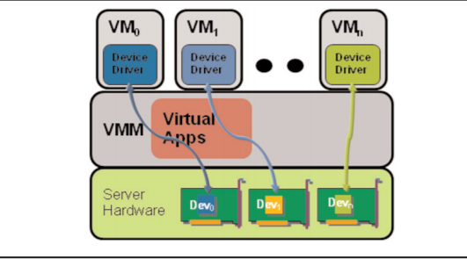
Intel® VT for Directed I/O (Intel® VT-d)
Intel VT-d Feature and Chipset Mapping
Intel® VT-d Base | hardware support for connecting physical devices to virtual addresses that support direct VM I/O
Interrupt Remapping Support | enables the VMM to isolate interrupts to CPUs assigned to a given VM and to remap/reroute physical I/O device interrupts.
Queued Invalidation Support | Queued-Invalidation enables the VMM to batch digital media translation invalidations.
Address Translation Services Support | allows PCI-e devices to cache the IOTLB entries (used for DMA remapping) of that device directly in the device itself
Support for PCI-SIG/IO Virtualization
Notes:
Intel® VT for Directed I/O (Intel® VT-d)
In computing, an input/output memory management unit (IOMMU) is a memory management unit (MMU) that connects a digital media adapter (DMA)-capable I/O bus to the main memory. Like a traditional MMU, which translates CPU-visible virtual addresses to physical addresses, the IOMMU takes care of mapping device-visible virtual addresses (also called device addresses or I/O addresses in this context) to physical addresses. Some units also provide memory protection from misbehaving devices.
Intel® VT-d is a feature integrated into the chipset and therefore not related to the CPU. Before Intel VT-d and hypervisors supporting it, any VM running on top of a VMM was seeing emulated, or para-virtualized, devices. Figure 4 shows how Intel VT-d works. No matter what type of hardware was physically present in the server, the VM itself sees a virtualized device. So, for example, on VMware vSphere*, you would typically see a VMXnet* network card instead of the real network interface card (NIC) installed on the server.
Interrupt-Remapping Support
The Interrupt-Remapping feature enables the VMM to isolate interrupts to CPUs assigned to a given VM and to remap/reroute physical I/O device interrupts. When enabled, this feature helps ensure an efficient migration of the interrupts across CPUs
Address Translation Services (ATS)
support Address Translation Services (ATS) is a PCISIG specification that allows PCI-e devices to cache the IOTLB entries (used for DMA remapping) of that device directly in the device itself. This helps the performance of high-end devices, since the translations can be cached at the device level and the device need not depend on the chipset IOTLB cache. This BIOS feature needs to be enabled to permit proper Intel VT-d implementation.
Single-Root I/O Virtualization (SR-IOV) The Single-Root I/O Virtualization (SR-IOV) feature is a PCI Special Interest Group (PCISIG) specification. Intel, along with other industry leaders, is actively participating in the PCI-SIG working group to define new standards for enhancing virtualization capabilities of I/O devices. SR-IOV provides a standard mechanism for devices to advertise their ability to be simultaneously shared among multiple virtual machines. It also allows for the partitioning of a PCI function into many virtual interfaces for the purpose of sharing the resources of a PCI Express* (PCIe*) device in a virtual environment. Intel plans to support the SR-IOV specification in its networking devices. Each virtual function can support a unique and separate data path for I/O-related functions within the PCIe hierarchy. Use of SRIOV with a networking device, for example, allows the bandwidth of a single port (function) to be partitioned into smaller slices that may be allocated to specific virtual machines, or guests, via a standard interface. A common methodology for configuration and management is also established to further enhance the interoperability of various devices in a PCIe hierarchy. This resource sharing can increase the total utilization of any given resource presented on an SR-IOVcapable PCIe device, potentially reducing the cost of a virtual system.

Slide 18
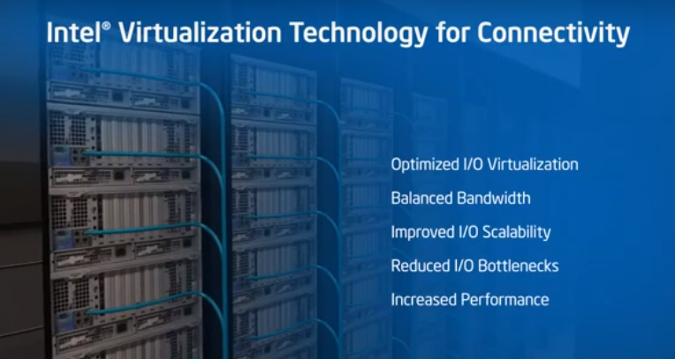
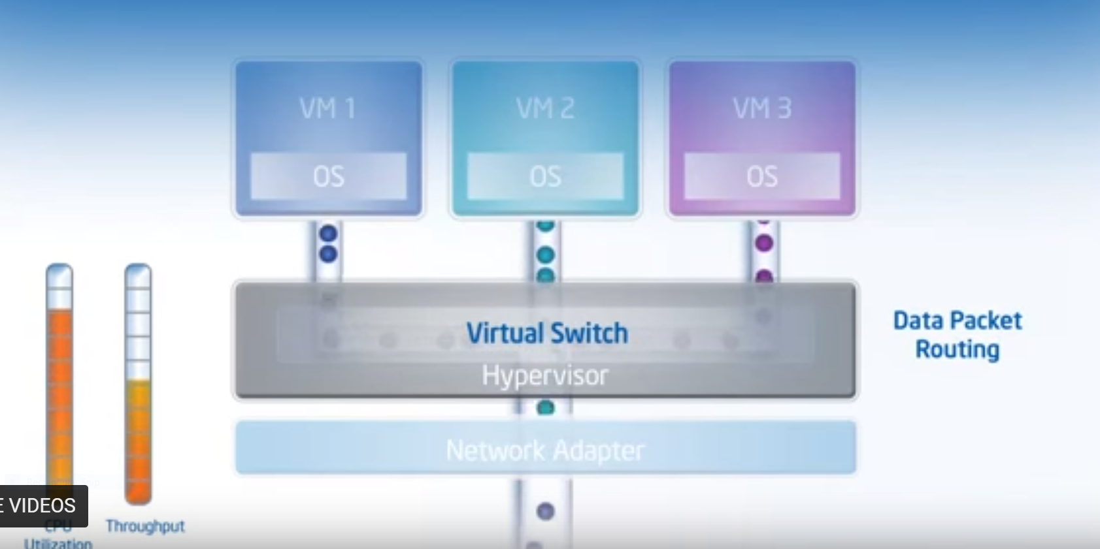
Intel® VT for Connectivity provides I/O Virtualization
Notes:
IT ce

Slide 19
Intel Graphics virtualization
Efficiency in today’s world often implies the use of cloud computing, and today’s cloud faces a growing share of media-rich workloads. While this impending reality has often presented a steep challenge, graphics virtualization technologies have emerged in response, to efficiently manage these workloads.
Intel offers a full suite of graphics virtualization technologies, known as Intel® Graphics Virtualization Technology (Intel® GVT), that offer different approaches with varying levels of performance, capabilities and sharing to best meet the needs of a wide range of developers.
Intel® Graphics Virtualization Technology –d (Intel® GVT –d): vDGA: virtual dedicated graphics acceleration (one VM to one physical GPU)
Intel® Graphics Virtualization Technology –s (Intel® GVT -s): vSGA: virtual shared graphics acceleration (multiple VMs to one physical GPU)
Intel® Graphics Virtualization Technology –g (Intel® GVT -g): vGPU: virtual graphics processing unit (multiple VMs to one physical GPU)

Slide 20
Summary of Intel® Virtualization Technology

Slide 21
Real-Time Systems

Slide 22
Hard VS. Soft Real-Time Requirements
The primary difference between hard and software real-time systems is the consequences of missing a scheduling deadline.
Hard Real-Time: scheduling deadlines must be met every single time. Missing the deadline means the system has failed, possibly with catastrophic consequences.
Robotic assembly line that require a high degree of timing accuracy
Software for dropping control rods in a nuclear power plant
Soft Real-Time: can tolerate missing a deadline occasionally, if an average latency is maintained.
A system reporting on the current activity of the assembly line will not have catastrophic results if the information is slightly delayed
Notes:
Hard versus Soft Real-Time
Real-time systems can be classified as either hard real-time or soft real-time. The primary difference between them is the consequences of missing a scheduling deadline. In hard real-time, the scheduling deadline must be met every single time. Missing the deadline means the system has failed, possibly with catastrophic consequences.
A good example of hard real-time is a fly-by-wire flight control system where a computer intervenes between the pilot and the engine and control surfaces. The control algorithm depends on precisely timed samples of airspeed, altitude, rate of climb or descent, and so on. If these samples are late, the algorithm can become unstable and the plane crashes.
Soft real-time can tolerate missing a deadline occasionally, if an average latency is maintained. The scheduling deadline is more of a goal than an absolute. A good example of soft real-time is the network of automated teller machines. “Come on,” I hear you say, “the ATM network isn’t real-time.” Oh yes it is, because when you put your card in that machine, you expect a response within a few seconds. So the designers of the ATM network have set a goal of responding in, say, 5 seconds. But they are not going to get terribly upset if occasionally it takes a few seconds longer. After all, what’s the worst that can happen? You get annoyed.

Slide 23
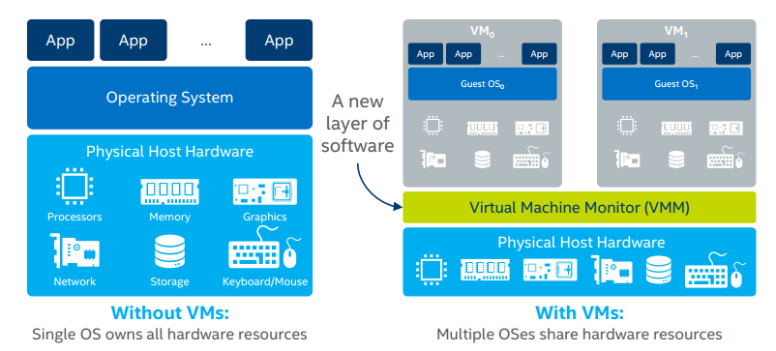
Hypervisor Architecture

Slide 24
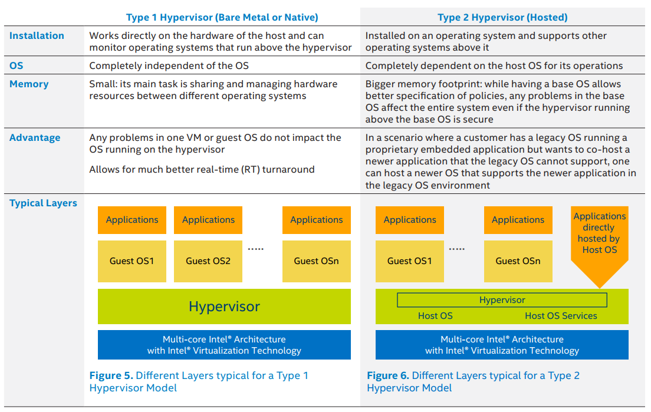
Real-Time Hypervisors

Slide 25
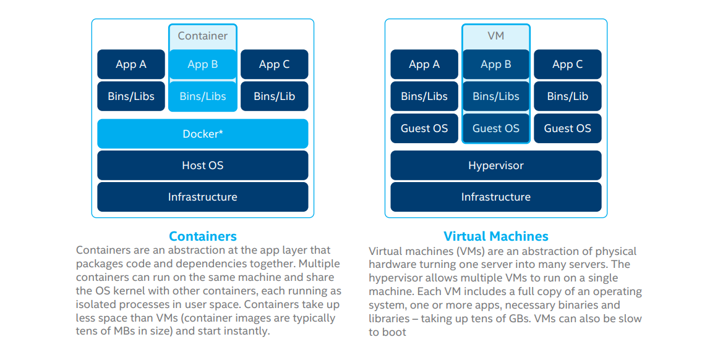
Virtualization VS Containerization
Notes:
Containers vs Virtual Machines
Research: Kata containers
Research

Slide 26
Why Linux is Not A Real-Time OS
Coarse-grained Synchronization
kernel system calls are not preemptible
Paging
swapping pages in and out of virtual memory is unbounded
Latency to external storage is not predictable
Fairness
scheduler may give the processor to a low priority process that has been waiting a long time
Request Reordering
Batching
Notes:
Linux was conceived and built as a general-purpose multiuser operating system in the model of Unix. The goals of a multiuser system are generally in conflict with the goals of real-time operation. General purpose operating systems are tuned to maximize average throughput even at the expense of latency, while real-time operating systems attempt to minimize, and place an upper bound on, latency, sometimes at the expense of average throughput.
There are several reasons why standard Linux is not considered suitable for real-time use:
• “Coarse-grained Synchronization”: This is a fancy way of saying that kernel system calls are not preemptible. Once a process enters the kernel, it cannot be preempted until it is ready to exit the kernel. Actually, this is no longer the case. Much kernel code is now preemptible, and preemption is a kernel configuration option.
• Paging: The process of swapping pages in and out of virtual memory is, for all practical purposes, unbounded. We have no way of knowing how long it will take to get a page off of a disk drive, and so we simply cannot place an upper bound on the time a process may be delayed due to a page fault.
• “Fairness” in Scheduling: Reflecting its Unix heritage as a multiuser time-sharing system, the conventional Linux scheduler does its best to be fair to all processes. Thus, the scheduler may give the processor to a low priority process that has been waiting a long time, even though a higher priority process is ready to run. It should be noted, though, that the scheduler has improved substantially over the years to the point where standard Linux could be considered soft real-time.
• Request Reordering: Linux reorders I/O requests from multiple processes to make more efficient use of hardware. For example, hard disk block reads from a lower priority process may be given precedence over read requests from a higher priority process in order to minimize disk head movement or improve the chances of error recovery.
• “Batching”: Linux will batch operations to make more efficient use of resources. For example, instead of freeing one page at a time when memory gets tight, Linux will run through the list of pages, clearing out as many as possible, delaying the execution of all processes.
Years ago the consequences of these issues in using Linux, or even Windows on a PC, were noticeable. Back in the day, moving the mouse while executing a compute-intensive function like rendering a complex graphics image would cause the mouse to occasionally stop and then jump, because the compute- or I/O-bound process had the CPU locked up. With today’s high speed, multicore processors coupled with the vastly improved Linux scheduler, this is not nearly as noticeable.
The net effect of all these characteristics is that we cannot put an upper bound on the latency that a user task or process may encounter. By definition this is not real-time.
MEASURING LATENCY: CYCLICTEST
There is a tool called cyclictest that measures latency. The basic operation of cyclictest is relatively trivial, as shown in Listing 17.

Slide 27
Strategies for Soft Real-Time Linux
Scheduling policy
Preemption Improvement
No Forced Preemption (Server):
Voluntary Kernel Preemption (Desktop)
Pre-emptible Kernel (Low-Latency Desktop)
Disable support for memory paging
PREEMPT_RT Patch – a project whose goal is to implement hard real-time behavior in the Linux kernel. Implements Interrupt
Notes:
• No Forced Preemption (Server): This is the traditional Linux preemption model, intended to maximize throughput. This is the preferred model for server applications. System call returns and interrupts are the only preemption points.
• Voluntary Kernel Preemption (Desktop): This option reduces the latency of the kernel by adding more “explicit preemption points” to the kernel code, at the cost of slightly lower throughput. In addition to explicit preemption points, system call returns and interrupt returns are still implicit preemption points.
• Preemptible Kernel (Low-Latency Desktop): This option reduces the latency of the kernel even further by making all kernel code that is not executing in a critical section preemptible. An implicit preemption point is located after each preemption disable section.
Note, by the way, that when we speak of kernel preemption, we are referring to process latency, not interrupt latency. With a standard uni-processor Linux kernel, interrupt latency is on the order of 10 microseconds or less, depending of course on processor speed. As noted above, maximum processlatency for a standard kernel is in the tens of milliseconds. The preemption improvement strategy reduces that to one to two milliseconds.
The advantage to the preemption improvement approach is that the real-time applications run in user space, just like any Linux application using the familiar Linux/POSIX APIs. Real-time processes are subject to the same memory protection rules as ordinary processes. But it is still not hard real-time. Latency is reduced, but there are simply too many execution paths in the kernel to permit comprehensive analysis of determinism.
Along with kernel preemption, the process scheduler has undergone several major overhauls over the years. The original scheduler, in use through the 2.4 series, exhibited what is called O(n) behavior, meaning that the time required to schedule the next process was proportional to the number of ready processes in the queue. That is, the scheduler traversed the entire queue to determine which process had the highest claim on the processor at this instant in time.
So-called “big-O” notation is a way of representing the time complexity of algorithms as a function of the number of inputs. Many algorithms exhibit O(n) behavior, while others can be much worse, as in O(n²) or, really bad, O(n!). Most of the time, the best behavior is O(1), meaning that the execution time is constant with respect to the number of inputs. But, on the other hand, if the constant time is 3 hours, it might be better to look at an O(n) algorithm that may actually run faster for the most likely number of inputs.
The scheduler introduced in the 2.6 series exhibited O(1) behavior meaning that the scheduling time is independent of the number of ready processes. Kernel version 2.6.23 introduced the Completely Fair Scheduler (CFS), where the run queue is replaced by what is called a Red-Black Tree. It is an O(log n) algorithm. Choosing the next task to run is constant time, but inserting a preempted task back in the tree is log n. The CFS also features nanosecond timing granularity.
We should take a quick look at another configuration option that surfaced in the 2.6 kernel. You now have the option to turn off virtual memory. No more paging! This addresses the second major impediment to real-time behavior in Linux listed at the beginning of the chapter.
Turning off virtual memory is fine, as long as you can anticipate the maximum amount of memory your system will require. In fact, in an embedded situation this is often possible. You know what applications will be running and how much memory they require. So just make sure that much RAM is available.
The option to turn off virtual memory is called “Support for paging of anonymous memory” and shows up under “General setup” in the configuration menu.
In parallel with all the work on preemption improvement and the scheduler, another project called the PREEMPT_RT Patch has been ongoing. The goal of this project is to implement true hard real-time behavior in the Linux kernel. The key point of the PREEMPT_RT patch is to minimize the amount of kernel code that is nonpreemptible, while also minimizing the amount of code that must be changed in order to provide this added preemptibility.
Another significant feature of the PREEMPT_RT patch is how it handles interrupts. The upper, A, portion of Fig. 17.1 shows how interrupts are normally handled. When the interrupt occurs, the interrupt handler of necessity preempts the currently running task to do whatever is necessary to service the interrupt. The interrupted task is held off for as long as it takes. In a PREEMPT_RT kernel, all the interrupt handler does is wake up a corresponding interrupt kernel thread, as shown in the B part of Fig. 17.1. The kernel thread is scheduled by the scheduler. It is possible that the currently running task has higher priority than the interrupt thread, so it continues to run following the interrupt handler. In principle, this gives us better control over scheduling.

Slide 28
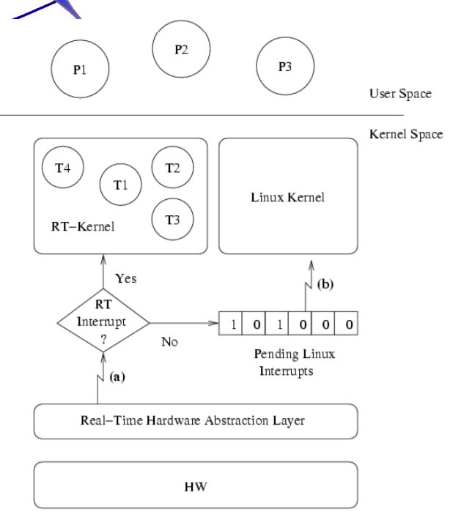
INTERRUPT ABSTRACTION
In many applications, only a small part of the process requires real-time performance.
Run Linux as a low priority process on a small real-time hypervisor
Notes:
The improvements in the mainline kernel, while significant, still do not get us to deterministic, real-time performance. Even though the default scheduler is very good, it still attempts to be “fair.” There is also the problem of the block I/O system reordering and combining I/O requests in the interest of maximizing throughput. So we need to circumvent these issues, at least for the parts of the application that are truly real-time.
It turns out that in a great many applications, only a small part of the system truly requires hard real-time determinism. Controlling a high-speed PID loop or moving a robot arm are examples of hard real-time requirements. But logging the temperature the PID loop is trying to maintain, or graphically displaying the current position of the robot arm, are generally not real-time requirements.
The alternate, and some would say more expedient, approach to real-time performance in Linux relies on this distinction between what is real-time and what is not. The technique is to run Linux as the lowest priority task (the idle task if you will) under a small real-time kernel. The real-time functions are handled by higher priority tasks running under this kernel. The non real-time stuff, like graphics, file management, and networking, which Linux already does very well, is handled by Linux.
This approach is called “Interrupt Abstraction,” because the real-time kernel takes over interrupt handling from Linux. The Linux kernel “thinks” it is disabling interrupts, but it really is not. The essence of interrupt abstraction is illustrated in Fig. 17.2. The real-time kernel effectively intercepts hardware interrupts before they get to the Linux kernel. Linux no longer has direct control over enabling and disabling interrupts. So when Linux says disable interrupts, the RT kernel simply clears an internal software interrupt enable flag, but leaves interrupts enabled. When a hardware interrupt occurs, the RT kernel first determines to whom it is directed:

Slide 29
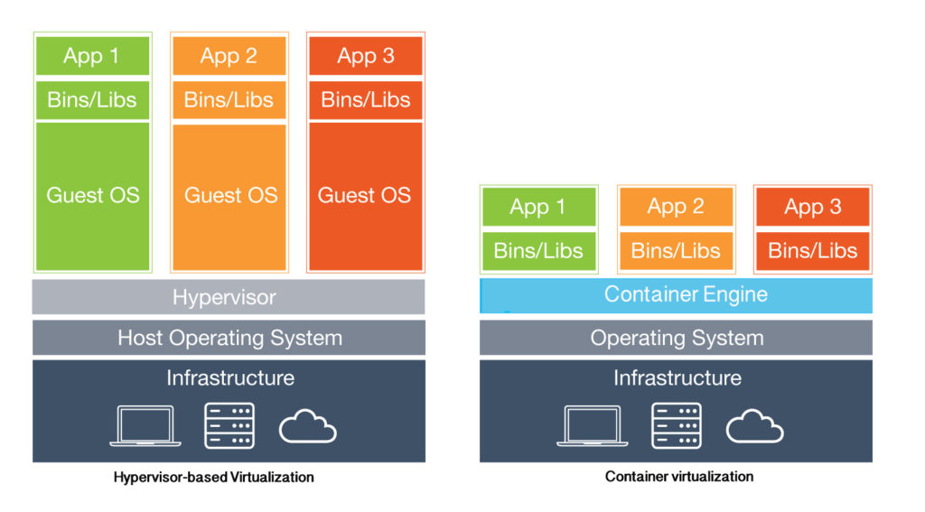
Virtual Machines vs. Containers
Notes:
https://www.mirantis.com/blog/containers-vs-vms-eternal-debate/

Slide 30
IA FEATURES LEVERAGED BY TITANIUM CONTROL
Platform Feature | Description | Technology Baseline | Use Cases | Titanium Control Implementation | Benefits
Vt-X | Accelerates virtual machines to near bare metal performance | Xeon / XeonD | Near native virtualized CPU performance | Performance enhancement of VMs, live migration from one Intel CPU generation to another | Performance and scalability
Vt-D | Enables physical NICs and/or GPUs to be mapped directly to virtual machine | Xeon/ XeonD | Native I/O performance | PCI Passthrough and SR-IOV support | Performance and salability
AVX-512 | Enables high performance vector workloads | Xeon Skylake Xeon Scalable Processor | Telecom, AI, high performance storage, encryption and compression | Enhanced KVM performance, guest AVX-512 support | Performance and scalability
Trusted Execution Technology | Used to attest system authenticity and state | TPM 2.0 | Secure boot and verified system state | Secure boot, TPM 2.0 storage of communication keys, vTPM 2.0 support in guests. | Security
AES-NI | Accelerates encryption/decryption | Xeon Westmere + | Full disk encryption and faster communications | Linux encryption performance enhancements | Security
UEFI Boot | Used for secure booting | UEFI Spec 2.6+ | Secure booting and faster boot | Fast boot, secure boot | Security

Slide 31
IA FEATURES LEVERAGED BY TITANIUM CONTROL #2
Platform Feature | Description | Technology Baseline | Use Cases | Titanium Control Implementation | Benefits
DPDK | Library to accelerate networking path | Intel DPDK | High speed VM-to-VM networking | Optimized DPDK libraries | Performance and scalability
QuickAssist | Hardware-based compression and encryption | Coleto Creek, VT-d | Exposing QuickAssist engine to VMs and virtualization of QuickAssist across VMs | Support PCI passthrough and SR-IOV access for VMs to QuickAssist accelerators | Security
Enhanced Platform Awareness (EPA) | Set of enabling features that take full advantage of Intel Architecture through OpenStack |  | Performance / determinism controls such as core pinning, NUMA awareness / controls, hyperthreading awareness / controls, CPU model selection | Suite of features that provide fine grained control for VMs. Can specify core pinning, NUMA affinity to vSwitch and NICs, split NUMA VMs, hyperthreading isolate or require, select CPU model to enable / disable CPU capabilities / instruction sets, huge page sizes. | Performance and scalability

Slide 32
IA FEATURES LEVERAGED BY TITANIUM CONTROL #3
Platform Feature | Description | Technology Baseline | Use Cases | Titanium Control Implementation | Benefits
BMC / IPMI | Integration with BMCs for hardware monitoring |  | Discovery of and monitoring of hardware through BMC using IPMI | Integration with BMCs to discover and collect hardware sensor data with capability to alarm on the values. | Open standards
Cache Allocation Technology (CAT) | Ability to isolate portions of cache for improved determinism | All SKUs starting with the Xeon E5 v4 family | Isolating cache of critical VM from noisy neighbor to guarantee performance | Under evaluation / development | Performance and scalability

Slide 33
Multi-function Controller with VxWorks
ROCKWELL Compact logix 5480 controller
Windows
Windows App
Opportunity | Problems Solved
Core CPU with real-time Hypervisor | Ability to run Windows Applications alongside real-time Control Engine Leveraging existing PLC install base and extending value/revenue stream of assets
Logix Control
Engine
Windows App
Windows App
Realtime Hypervisor (VxWorks)
Core i7
Intel Confidential

Slide 34
Workload consolidation without virtualization
Beckhoff Cx2072 controller
Opportunity | Problems Solved
High-end multi core Xeon CPUs | Maximum performance by direct assignment of workloads to cores (no Hypervisor) Differentiation over competitor products Workloads assigned statically from Twincat environment
Machine
Vision
System
Monitoring
PLC
Realtime
Control
Windows
Windows
Windows
No Hypervisor
……
……
12-Core Xeon
Intel Confidential
Notes:
Slide okayed

Slide 35
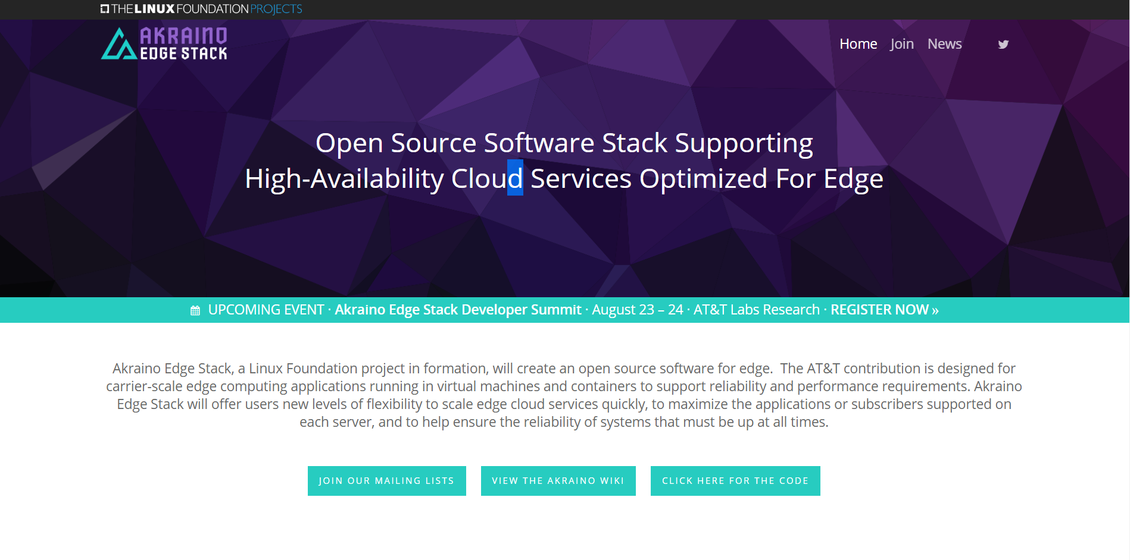

Slide 36
Installing RT-tests
pmgtest – start pairs of threads and measure the latency of the interprocess communication
cyclictest – test the latency of switching between processes
ptsematest – start pairs of threads and measure the latency of communications through POSIX mutexes.
svsematest – start pairs of threads and measure the latency of communications through SYSV mutexes.
hackbench – stress test the Linux scheduler using processes communication through sockets or pipes.
sendme – sends a signal from a driver to a user and measures the latency
signaltest – measures latency of POSIX signals
Notes:
Backfire, pip_test, sigwaittest

Slide 37
MEASURING LATENCY: CYCLICTEST

Slide 38
Resources
https://software.intel.com/en-us/articles/intel-virtualization-technology-for-directed-io-vt-d-enhancing-intel-platforms-for-efficient-virtualization-of-io-devices

